Slide 2
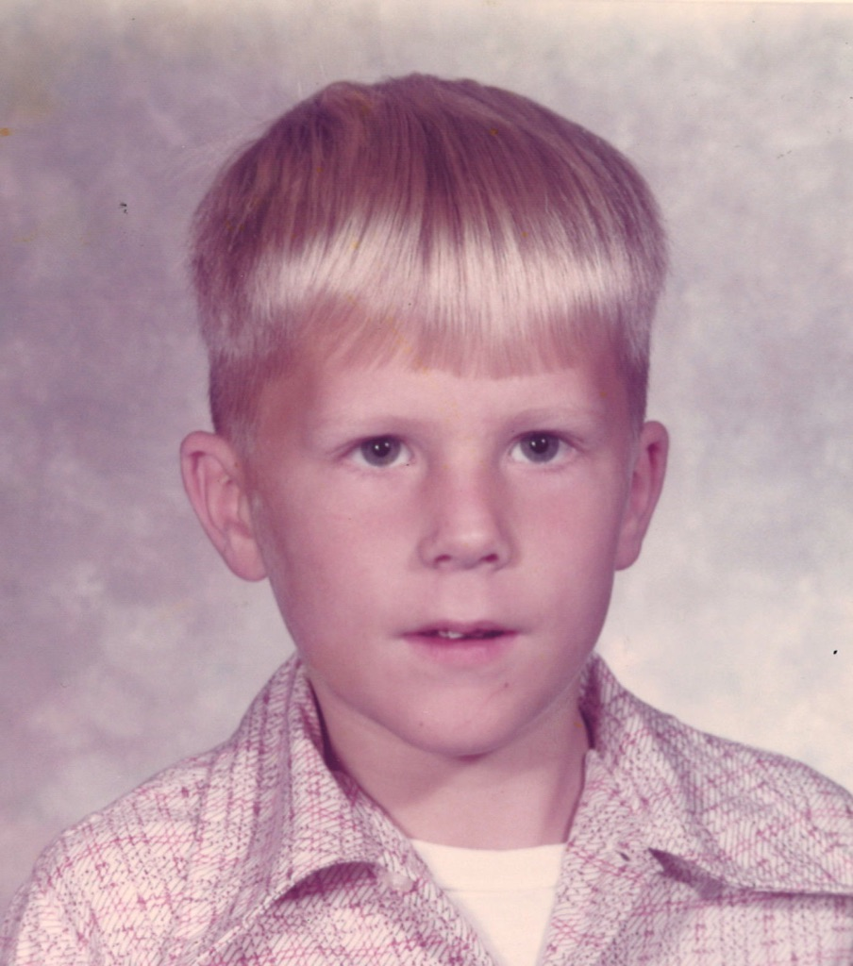
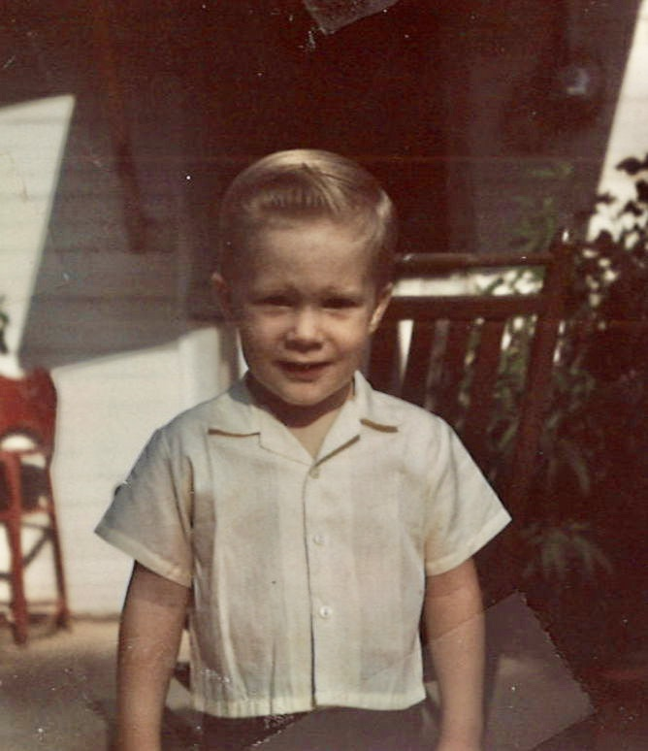
Jeff Holeman 👉 Married to Liesa (30 years in December.) 👉 Graduate of Ole Miss. (1989) 👉 Graduate of New Orleans Seminary (1994) 👉 Graduate of Spanish Language Institute, Costa Rica. (2008) 👉 Currently pursuing Doctor of Ministry at New Orleans Seminary. 👉 32 years in ministry. (Yazoo City, Gulfport, Kosciusko, Arlington, TX, Oxford) 👉 10 years as Missionary in Costa Rica, Peru, and Mexico facilitating the planting of 31 churches. 👉 13 years on staff at FBC Oxford.

Slide 3
September..
1 – The Best work to build Biblical Community.
8 – The Best reach out those on the edge.
15 – The Best teach for application.
22 – The Best know the roles.
29 – The Best understand discipleship.

Slide 4
Sunday School is the catalyst for building Biblical Community at First Baptist Oxford.
Biblical Community in ACTS.
Devotion .. Acts 2:42-43. Devoted to the Word and to Fellowship.
Compassion .. Acts 2:44-45. Helping others face the unexpected.
Frequency .. Acts 2:46-47. Nothing gets in the way.
Growth .. Acts 2:47. Authentic Christianity attracts lost people.
Acts 2:42-47
42 They devoted themselves to the apostles’ teaching, to the fellowship, to the breaking of bread, and to prayer. 43 Everyone was filled with awe, and many wonders and signs were being performed through the apostles. 44 Now all the believers were together and held all things in common. 45 They sold their possessions and property and distributed the proceeds to all, as any had need. 46 Every day they devoted themselves to meeting together in the temple, and broke bread from house to house. They ate their food with joyful and sincere hearts, 47 praising God and enjoying the favor of all the people. Every day the Lord added to their number those who were being saved.

Slide 5
Sunday School is the catalyst for building Biblical Community at First Baptist Oxford.
A SAFE ZONE IS NEEDED
FOR BIBLICAL COMMUNITY.
Levels of sharing…
5 Sharing Who You Are
4 Sharing How You Feel
3 Sharing Opinions or Ideas
2 Sharing Facts
1 Sharing cultural greetings
Trust

Slide 6
Sunday School is the catalyst for building Biblical Community at First Baptist Oxford.
Understanding the Time Zones..
Formal
Living life is more than meeting.
Sunday at 9:45 am or your time.
Structure (Announcements, Prayer time, Study time, Application time.)
Informal
Time before the meeting.
Time after the meeting.
Once a month fellowship time.
Fun, Memories, Serving, See people in different ways.
Safe Zones happen because of Informal Times.

Slide 7
Sunday School is the catalyst for building Biblical Community at First Baptist Oxford.
THE BEST SUNDAY SCHOOL TEACHERS REACH OUT TO THOSE ON THE EDGE.
Acts 2:42-47
42 They devoted themselves to the apostles’ teaching, to the fellowship, to the breaking of bread, and to prayer. 43 Everyone was filled with awe, and many wonders and signs were being performed through the apostles. 44 Now all the believers were together and held all things in common. 45 They sold their possessions and property and distributed the proceeds to all, as any had need. 46 Every day they devoted themselves to meeting together in the temple, and broke bread from house to house. They ate their food with joyful and sincere hearts, 47 praising God and enjoying the favor of all the people. Every day the Lord added to their number those who were being saved.

Slide 8
Sunday School is the catalyst for building Biblical Community at First Baptist Oxford.
REASONS PEOPLE ARE ON THE EDGE…
Some people feel USELESS.
1 Peter 4:10.. As each one has received a gift, use it to serve others.
Sit, Soak, Serve or Sour.
Some people are HURTING.
Hurt People Hurt People.
Hurt by the church. Healing always boils down to ‘tears, talking, time.’
Hurt by Life. A church without broken people is a broken church.
Some people are not DISCIPLED.
It’s easier to be a Consumer than a Co-laborer.
Unhealthy and Unrealistic Expectations.
Hebrews 10:24.. Provoke love and good works.
Acts 2:42-47
42 They devoted themselves to the apostles’ teaching, to the fellowship, to the breaking of bread, and to prayer. 43 Everyone was filled with awe, and many wonders and signs were being performed through the apostles. 44 Now all the believers were together and held all things in common. 45 They sold their possessions and property and distributed the proceeds to all, as any had need. 46 Every day they devoted themselves to meeting together in the temple, and broke bread from house to house. They ate their food with joyful and sincere hearts, 47 praising God and enjoying the favor of all the people. Every day the Lord added to their number those who were being saved.

Slide 9
Sunday School is the catalyst for building Biblical Community at First Baptist Oxford.
REACHING OUT TO THOSE ON THE EDGE…
HAVE THE SAME EMOTIONS AS YOU HAVE WHEN YOU’VE LOST SOMETHING VERY VALUABLE. (Lost Sheep/Lost Coin)
REMEMBER THAT WHEN WE EXCLUDE THOSE ON THE EDGE WE MAY BE EXCLUDING CHRIST.
TAKE THE FIRST STEP. (Matt 5:23)
Phone call.. Can we meet?
Visit.. I’m sorry. Will you come back?
Yes. Work to rebuild Community.
No. Will you consider another church?
Psalm 147:3 .. He heals the brokenhearted.
DON’T HURRY THE PROCESS. BE PERSISTENT.
How patient is God with us?
Acts 2:42-47
42 They devoted themselves to the apostles’ teaching, to the fellowship, to the breaking of bread, and to prayer. 43 Everyone was filled with awe, and many wonders and signs were being performed through the apostles. 44 Now all the believers were together and held all things in common. 45 They sold their possessions and property and distributed the proceeds to all, as any had need. 46 Every day they devoted themselves to meeting together in the temple, and broke bread from house to house. They ate their food with joyful and sincere hearts, 47 praising God and enjoying the favor of all the people. Every day the Lord added to their number those who were being saved.

Slide 10
Sunday School is the catalyst for building Biblical Community at First Baptist Oxford.
IF YOU KNOW THE HURT IS SO BAD THEY WILL NEVER RETURN YOU MAY WANT TO CONSIDER A LETTER.. Most of the Letters in the New Testament were to help solve problems in the church.
Before you write, PRAY.
Encourage them to Read their Bible daily. Perhaps enclose a reading plan or a SS Book.
Encourage them to set the example that they seek in others. The body of Christ needs them.
Encourage them to ‘be Jesus with skin on’ and serve and show love to others. God wants to use them.
These gentle reminders may sting at first but will open the door to healing.

Slide 11
Sunday School is the catalyst for building Biblical Community at First Baptist Oxford.
THE BEST WITNESSES
FOR CHRIST
ARE THOSE WHO HAVE BEEN BROUGHT BACK FROM THE EDGE.
Acts 2:42-47
42 They devoted themselves to the apostles’ teaching, to the fellowship, to the breaking of bread, and to prayer. 43 Everyone was filled with awe, and many wonders and signs were being performed through the apostles. 44 Now all the believers were together and held all things in common. 45 They sold their possessions and property and distributed the proceeds to all, as any had need. 46 Every day they devoted themselves to meeting together in the temple, and broke bread from house to house. They ate their food with joyful and sincere hearts, 47 praising God and enjoying the favor of all the people. Every day the Lord added to their number those who were being saved.

Slide 12
Sunday School is the catalyst for building Biblical Community at First Baptist Oxford.
PREPARE YOUR SS CLASS FOR HURT.
COMMUNITY IS A
PLACE WHERE THE PERSON
YOU LEAST WANT TO LIVE
WITH ALWAYS LIVES.
-- HENRI NOUWEN
Acts 2:42-47
42 They devoted themselves to the apostles’ teaching, to the fellowship, to the breaking of bread, and to prayer. 43 Everyone was filled with awe, and many wonders and signs were being performed through the apostles. 44 Now all the believers were together and held all things in common. 45 They sold their possessions and property and distributed the proceeds to all, as any had need. 46 Every day they devoted themselves to meeting together in the temple, and broke bread from house to house. They ate their food with joyful and sincere hearts, 47 praising God and enjoying the favor of all the people. Every day the Lord added to their number those who were being saved.

Slide 13
Sunday School is the catalyst for building Biblical Community at First Baptist Oxford. The Best work to build Biblical Community in their group. The Best reach out to those on the edge. Next week.. The Best teach for application.

Slide 14
Questions?
wigtake@gmail.com
Office phone: 662-234-3515

