Slide 2
WHY ARE WE HERE?

Slide 3
You Love your kids.

Slide 4
You Love your kids.
We love your kids.

Slide 5
You Love your kids.
We love your kids.
We want your kids to encounter Jesus.

Slide 6
You Love your kids.
We love your kids.
We want your kids to encounter Jesus.
Parenting is tough.

Slide 7
You Love your kids.
We love your kids.
We want your kids to encounter Jesus.
Parenting is tough.
The current world of technology is overwhelming.

Slide 8
WHY ARE YOU HERE?

Slide 9
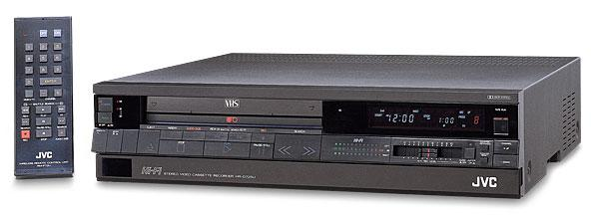
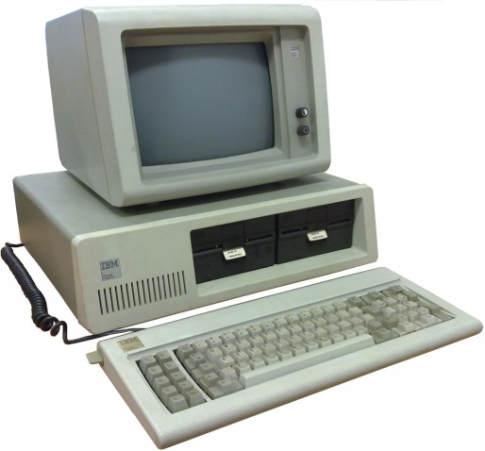
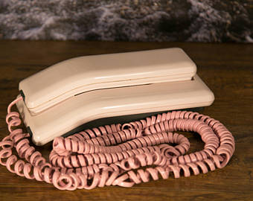
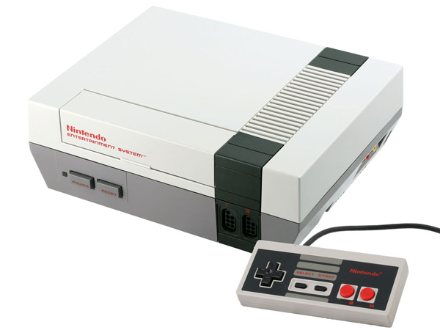
80s

Slide 10
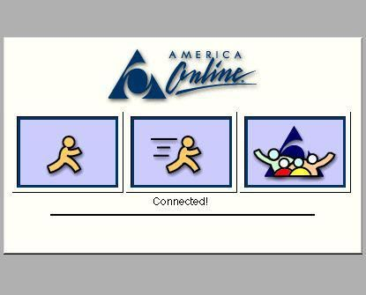
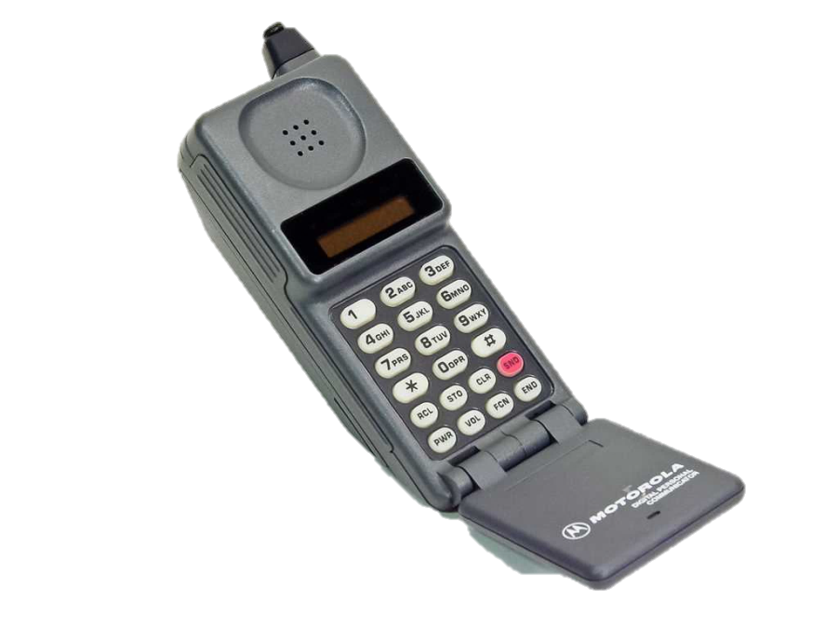
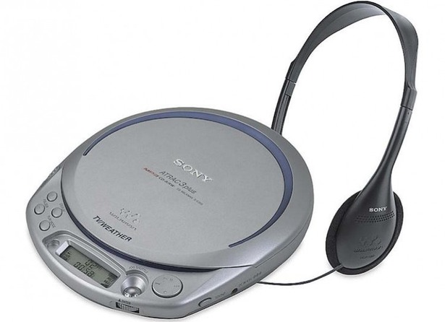
90s

Slide 11
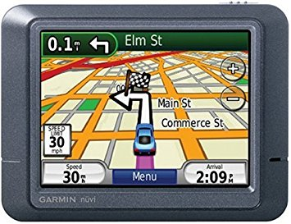
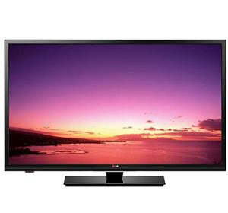
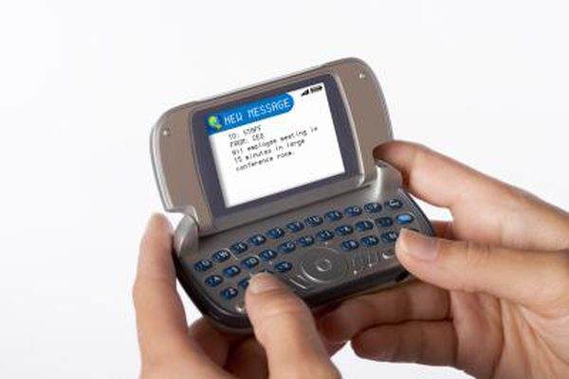
Ealy 00s

Slide 12
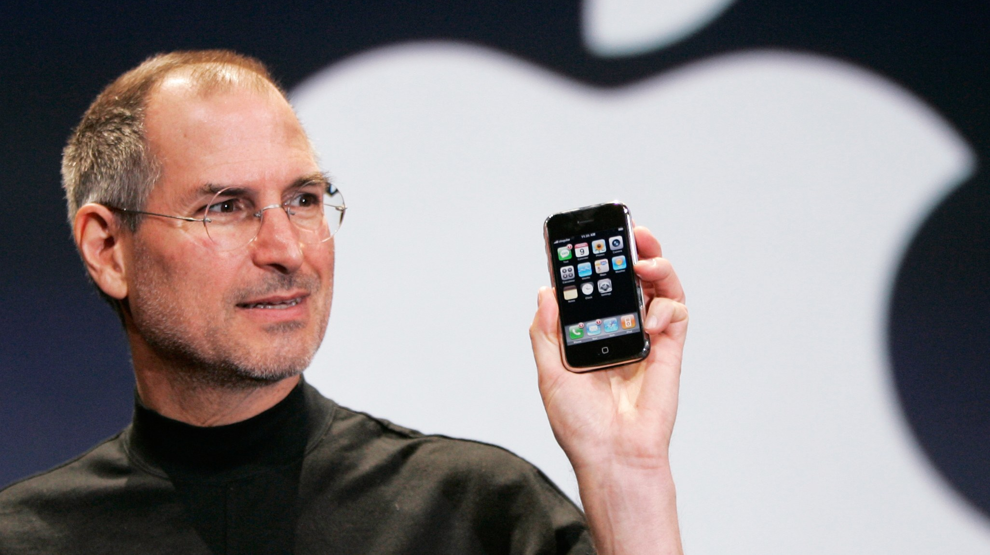
2007

Slide 13
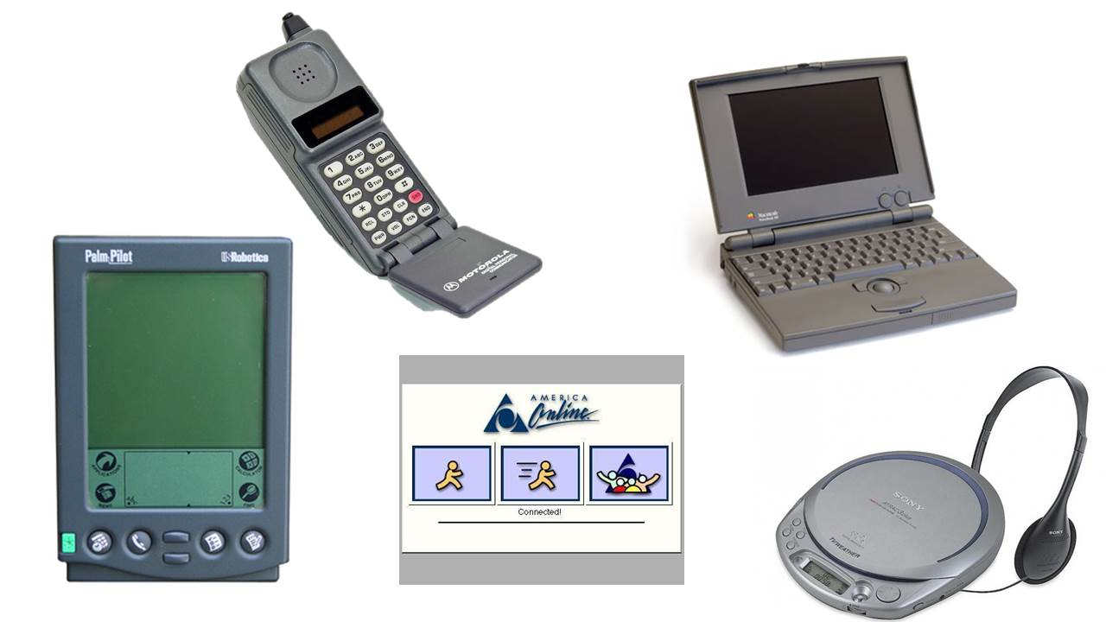
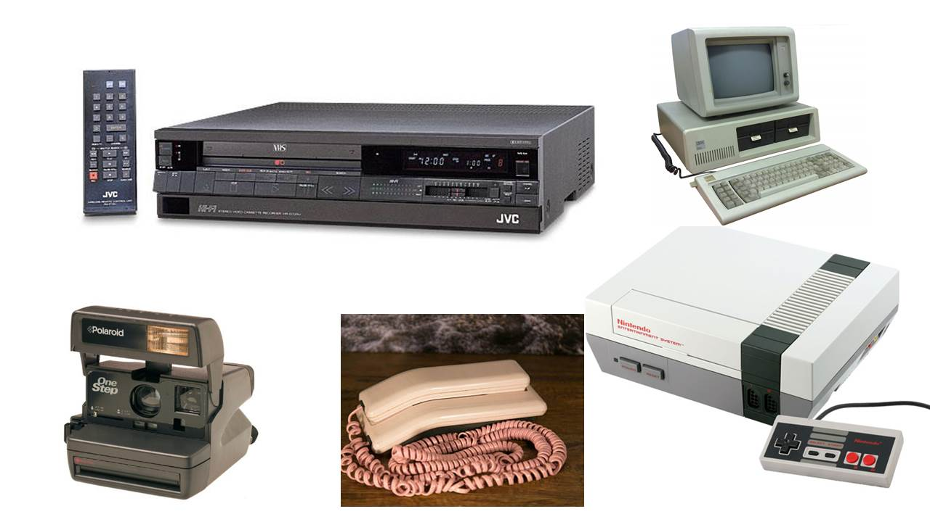

Slide 16
Current Digital Reality:

Slide 17
Current Digital Reality:
Constant connection

Slide 18
Statistics
36% of teens/26% of parents check phones
at least once during the night.
44% of teens get their news from YouTube.
Ages 8 to 12 spend 4:44 on average on-line per day.
<$35,000 income is 5:49 per day.
69% of 12 years olds have a smart phone.
Boys play games. Girls watch movies/music.

Slide 19
Statistics
Ages 13 to 18 spend 7:22 on average on-line per day.
<$35,000 income is 8:32 per day.
89% of 16 year olds have a smart phone.
36% of teen girls have sent nude/semi nude photos.
39% of teen boys have sent nude/semi nude photos.

Slide 20
Current Digital Reality:
Constant connection
Excessive Access

Slide 21
Current Digital Reality:
Constant connection
Excessive Access
Impersonal Communication

Slide 22
Current Digital Reality:
Constant connection
Excessive Access
Impersonal Communication
Immediate Reaction

Slide 23
OUR RESPONSE:
Alienation
The Church in a Bunker
Accommodation
The Church on a leash
Infiltration & Transformation
The Church in the world but not of the world

Slide 24
Romans 12:2
Do not conform to the pattern of this world, but be transformed by the renewing of your mind. Then you will be able to test and approve what God’s will is - his good, pleasing and perfect will.

Slide 25
Ephesians 5:15-17
Be very careful, then, how you live - not as unwise but as wise, making the most of every opportunity, because the days are evil. Therefore do not be foolish, but understand what the Lord’s will is.

Slide 26
TWO MAIN QUESTIONS:
What is out there that we need to know about?
What type of filters or controls are available?

Slide 27
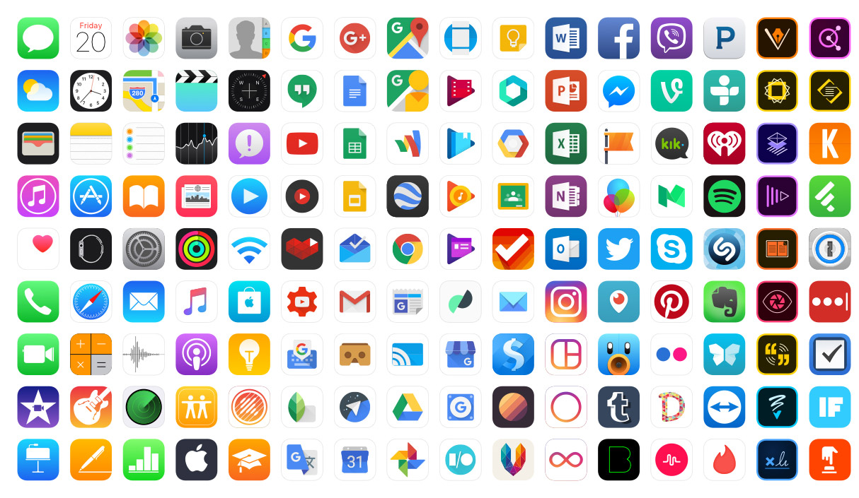

Slide 28
KNOW the social media platforms.
Finstas

Slide 29
KNOW the social media platforms.
KNOW their games.
Content (Ratings)
Consistency (How much time?)
Connections (Who are they with?)

Slide 30
KNOW the social media platforms.
KNOW their games.
KNOW where they are going digitally.

Slide 31
KNOW the social media platforms.
KNOW their games.
KNOW where they are going digitally.
KNOW where to go so you can know.

Slide 32
Where to Go…
CommonSenseMedia.org
FocusOnTheFamily.org
PluggedIn.com
SmartSocial.com
iParent.tv

Slide 34
Do you have a time alone with God and His Word each day so you will have the wisdom to guide your family?

Slide 35
Tell your teen what technology is not allowed, and you’ll help them for a season. Teach your teen how to healthily engage technology; they will be wise consumers for a lifetime.

Slide 36
RESTRICTIVE
PREPARATIVE

Slide 37
RESTRICTIVE
PREPARATIVE
Rules
Controls
Consequences

Slide 38
RESTRICTIVE
PREPARATIVE
WHEN
and
HOW
WHAT

Slide 39
PREPARATIVE:
WHEN will we allow our kids to have a ____________ ?

Slide 40
1 Timothy 4:12
Don’t let anyone look down on you because you are young, but set an example for the believers in speech, in conduct, in love, in faith and in purity.

Slide 41
2 Timothy 2:22
flee the evil desires of youth,

Slide 42
PREPARATIVE:
WHEN will we step in and WHEN will we step back?

