Slide 2
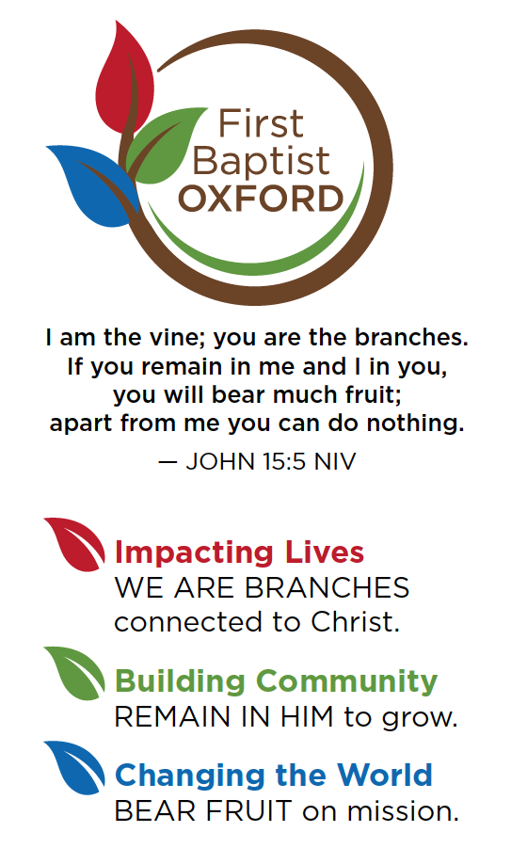
John 5:19 .. The Son can do nothing of Himself, unless it is something He sees the Father doing:
Why do we pray?
God commands us to pray.
Isaiah 55:6 .. Seek the Lord while he may be found; call upon him while he is near.
Prayer is a privilege.
Hebrews 4:16 .. Therefore, let us approach the throne of grace with boldness, so that we may receive mercy and find grace to help us in time of need.
A Great Tragedy of Life is Not Unanswered Prayer
But Unoffered Prayer.

Slide 3
You Can Be a Christian
And Not Pray
Just Like You Can Be Married
And Not Talk
To Your Spouse.
You’ll feel miserable.

Slide 4
EFFECTIVE PRAYER OCCURS WHEN YOU TALK TO GOD AND LISTEN TO WHAT GOD IS SAYING TO YOU.
TALKING PRINCIPLES OF PRAYER
PRINCIPLE #1 .. CONFESSION
GOD, I’M NOTHING WITHOUT YOU.
GOD, I HAVE SINNED AGAINST YOU BY __
TO CONFESS MEANS TO DESPISE THE SIN AND GRIEVING BECAUSE OF IT.
PRINCIPLE #2 .. PRAISE
PRAISING GOD FOR WHO HE IS AND NOT WHAT HE HAS DONE.
PRINCIPLE #3 .. THANKSGIVING
THANKING GOD FOR WHAT HE HAS DONE.
PRINCIPLE #4 .. PETITION
I EXPRESS MY TOTAL DEPENDENCE ON GOD.
PRINCIPLE #5 .. INTERCESSION
STAND IN THE GAP FOR THOSE YOU ARE CONCERNED ABOUT.

Slide 5
EFFECTIVE PRAYER OCCURS WHEN YOU TALK TO GOD AND LISTEN TO WHAT GOD IS SAYING TO YOU.
LISTENING PRINCIPLES OF PRAYER
PRINCIPLE #1 .. BE STILL AND QUIET BEFORE GOD.
AN OPEN BIBLE SHOULD ALWAYS ACCOMPANY A BENDED KNEE.
NO PHONES, TV, SOCIAL MEDIA.
PRINCIPLE #2 .. DO NOT BE IN A HURRY.
LEARN THE POWER OF WAITING.
PRINCIPLE #3 .. SPEND SEASONS WITH GOD
TIME SET ASIDE EACH DAY.
A DAY SET ASIDE PERIODICALLY.
A RETREAT OF SEVERAL DAYS.
ARE YOU BETTER AT TALKING OR LISTENING?

Slide 6
WHEN YOU DEPEND ON GOD YOU PRAY. WHEN YOU DEPEND ON YOU YOU DON’T PRAY.
PRAYER BARRIERS
PRIDE .. OVERESTIMATING YOU.
UNBELIEF .. UNDERESTIMATING GOD.
IGNORANCE .. OVERESTIMATING THE DIFFICULTY OF TALKING WITH GOD.
TIME .. UNDERESTIMATING THE BENEFITS OF BEING WITH GOD.

Slide 7
Question of the week?
Do we pray to God, Jesus,
or the Holy Spirit?
God the Creator.
Jesus the Savior.
The Holy Spirit the Enabler.
John 10:30 .. I and the Father are One.
Lord’s Prayer .. Our Father…
There’s no record of anyone praying to the HS in the Bible.
The HS gives us the words..Romans 8:26
Bottom Line .. There’s nothing sinful or wrong about praying to the Father, to Jesus, or to the HS.

Slide 8
2 Kings 6:15-17
15 When the servant of the man of God got up early and went out, he discovered an army with horses and chariots surrounding the city. So he asked Elisha, “Oh, my master, what are we to do?”
16 Elisha said, “Don’t be afraid, for those who are with us outnumber those who are with them.”
17 Then Elisha prayed, “Lord, please open his eyes and let him see.” So the Lord opened the servant’s eyes, and he saw that the mountain was covered with horses and chariots of fire all around Elisha.

Slide 9
Colossians 4:2-4
2 Devote yourselves to prayer; stay alert in it with thanksgiving.
3 At the same time, pray also for us that God may open a door to us for the word, to speak the mystery of Christ for which I am in chains,
4 so that I may make it known as I should.

Slide 10
A Healthy Prayer Life will be..
Devoted (Luke 18:1)
Alert (Jesus’ example in John 17)
Thankful (Philippians 4:6)
Shows who we trust.
Shows who we love.
Shows who we place above us.
About Others (Acts 14:27)
When you pray for the God to work, He will work in you.
A healthy prayer life…
Helps me see as God sees. (2 Kings 6)
Aligns my heart with God’s. (Mat 26:39)
2 Devote yourselves to prayer; stay alert in it with thanksgiving. 3 At the same time, pray also for us that God may open a door to us for the word, to speak the mystery of Christ for which I am in chains, 4 so that I may make it known as I should.

Slide 11
A Healthy Prayer Life
will include..
A Time
A Place
A Plan
A Bible
A Journal
A Goal
2 Devote yourselves to prayer; stay alert in it with thanksgiving. 3 At the same time, pray also for us that God may open a door to us for the word, to speak the mystery of Christ for which I am in chains, 4 so that I may make it known as I should.

Slide 12
2 Devote yourselves to prayer; stay alert in it with thanksgiving. 3 At the same time, pray also for us that God may open a door to us for the word, to speak the mystery of Christ for which I am in chains, 4 so that I may make it known as I should.

