Slide 2
ACTS 11
Gentile Salvation Defended
1 The apostles and the brothers and sisters who were throughout Judea heard that the Gentiles had also received the word of God. 2 When Peter went up to Jerusalem, the circumcision party criticized him, 3 saying, “You went to uncircumcised men and ate with them.”
4 Peter began to explain to them step by step, 5 “I was in the town of Joppa praying, and I saw, in a trance, an object that resembled a large sheet coming down, being lowered by its four corners from heaven, and it came to me. 6 When I looked closely and considered it, I saw the four-footed animals of the earth, the wild beasts, the reptiles, and the birds of the sky. 7 I also heard a voice telling me, ‘Get up, Peter; kill and eat.’
8 “‘No, Lord! ’ I said. ‘For nothing impure or ritually unclean has ever entered my mouth.’ 9 But a voice answered from heaven a second time, ‘What God has made clean, you must not call impure.’
10 “Now this happened three times, and everything was drawn up again into heaven. 11 At that very moment, three men who had been sent to me from Caesarea arrived at the house where we were. 12 The Spirit told me to accompany them with no doubts at all. These six brothers also accompanied me, and we went into the man’s house. 13 He reported to us how he had seen the angel standing in his house and saying, ‘Send to Joppa, and call for Simon, who is also named Peter. 14 He will speak a message to you by which you and all your household will be saved.’
15 “As I began to speak, the Holy Spirit came down on them, just as on us at the beginning. 16 I remembered the word of the Lord, how he said, ‘John baptized with water, but you will be baptized with the Holy Spirit.’ 17 If, then, God gave them the same gift that he also gave to us when we believed in the Lord Jesus Christ, how could I possibly hinder God?”
18 When they heard this they became silent. And they glorified God, saying, “So then, God has given repentance resulting in life even to the Gentiles.”

Slide 3
Peter’s Calling (Luke 5)
4 When he had finished speaking, he said to Simon, “Put out into deep water and let down your nets for a catch.” 5 “Master,” Simon replied, “we’ve worked hard all night long and caught nothing. But if you say so, I’ll let down the nets.” 6 When they did this, they caught a great number of fish, and their nets began to tear. 7 So they signaled to their partners in the other boat to come and help them; they came and filled both boats so full that they began to sink. 8 When Simon Peter saw this, he fell at Jesus’s knees and said, “Go away from me, because I’m a sinful man, Lord!” 9 For he and all those with him were amazed at the catch of fish they had taken, 10 and so were James and John, Zebedee’s sons, who were Simon’s partners. “Don’t be afraid,” Jesus told Simon. “From now on you will be catching people.” 11 Then they brought the boats to land, left everything, and followed him.

Slide 4
James 5:16
The prayer of a righteous person
Is very powerful in its effect.
Peter’s own words in 1 Peter 2
21 For you were called to this, because Christ also suffered for you, leaving you an example, that you should follow in his steps. 22 He did not commit sin, and no deceit was found in his mouth; 23 when he was insulted, he did not insult in return; when he suffered, he did not threaten but entrusted himself to the one who judges justly. 24 He himself bore our sins in his body on the tree; so that, having died to sins, we might live for righteousness. By his wounds you have been healed. 25 For you were like sheep going astray, but you have now returned to the Shepherd and Overseer of your souls.

Slide 5
RIGHTEOUS
Our only hope for righteousness is
to follow Jesus.
1 Peter 2:24 .. He himself bore our sins in his body on the tree, that we might die to sin and live to righteousness. By his wounds you have been healed.
The ONLY path to a powerful prayer life is
to hold everything loosely and follow Jesus.

Slide 6
How do I know I’m following Jesus?
My Attitude is like Jesus’ attitude.
I think like Jesus.
My Actions are like Jesus’s actions.
I am Jesus with skin on.
My Affections are like Jesus’ affections.
I love like Jesus.

Slide 7
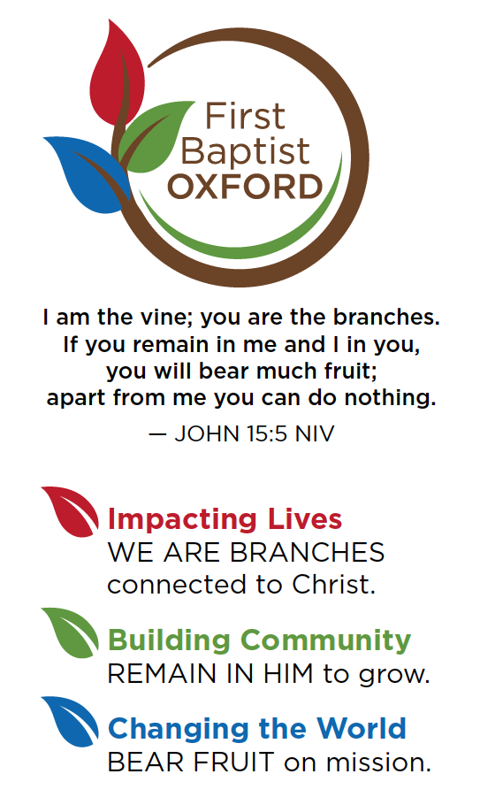
John 5:19 .. The Son can do nothing of Himself, unless it is something He sees the Father doing:
Why do we pray?
God commands us to pray.
Isaiah 55:6 .. Seek the Lord while he may be found; call upon him while he is near.
Prayer is a privilege.
Hebrews 4:16 .. Therefore, let us approach the throne of grace with boldness, so that we may receive mercy and find grace to help us in time of need.
A Great Tragedy of Life is Not Unanswered Prayer
But Unoffered Prayer.

Slide 8
EFFECTIVE PRAYER OCCURS WHEN YOU TALK TO GOD AND LISTEN TO WHAT GOD IS SAYING TO YOU.
TALKING PRINCIPLES OF PRAYER
PRINCIPLE #1 .. CONFESSION
GOD, I’M NOTHING WITHOUT YOU.
GOD, I HAVE SINNED AGAINST YOU BY __
TO CONFESS MEANS TO DESPISE THE SIN AND GRIEVING BECAUSE OF IT.
PRINCIPLE #2 .. PRAISE
PRAISING GOD FOR WHO HE IS AND NOT WHAT HE HAS DONE.
PRINCIPLE #3 .. THANKSGIVING
THANKING GOD FOR WHAT HE HAS DONE.
PRINCIPLE #4 .. PETITION
I EXPRESS MY TOTAL DEPENDENCE ON GOD.
PRINCIPLE #5 .. INTERCESSION
STAND IN THE GAP FOR THOSE YOU ARE CONCERNED ABOUT.

Slide 9
EFFECTIVE PRAYER OCCURS WHEN YOU TALK TO GOD AND LISTEN TO WHAT GOD IS SAYING TO YOU.
LISTENING PRINCIPLES OF PRAYER
PRINCIPLE #1 .. BE STILL AND QUIET BEFORE GOD.
AN OPEN BIBLE SHOULD ALWAYS ACCOMPANY A BENDED KNEE.
NO PHONES, TV, SOCIAL MEDIA.
PRINCIPLE #2 .. DO NOT BE IN A HURRY.
LEARN THE POWER OF WAITING.
PRINCIPLE #3 .. SPEND SEASONS WITH GOD
TIME SET ASIDE EACH DAY.
A DAY SET ASIDE PERIODICALLY.
A RETREAT OF SEVERAL DAYS.
ARE YOU BETTER AT TALKING OR LISTENING?

Slide 10
WHEN YOU DEPEND ON GOD YOU PRAY. WHEN YOU DEPEND ON YOU YOU DON’T PRAY.
PRAYER BARRIERS
PRIDE .. OVERESTIMATING YOU.
UNBELIEF .. UNDERESTIMATING GOD.
IGNORANCE .. OVERESTIMATING THE DIFFICULTY OF TALKING WITH GOD.
TIME .. UNDERESTIMATING THE BENEFITS OF BEING WITH GOD.

Slide 11
A Healthy Prayer Life will be..
Devoted (Luke 18:1)
Alert (Jesus’ example in John 17)
Thankful (Philippians 4:6)
About Others (Acts 14:27)
A healthy prayer life…
Helps me see as God sees. (2 Kings 6)
Aligns my heart with God’s. (Mat 26:39)
Colossians 4 - 2 Devote yourselves to prayer; stay alert in it with thanksgiving. 3 At the same time, pray also for us that God may open a door to us for the word, to speak the mystery of Christ for which I am in chains, 4 so that I may make it known as I should.

Slide 12
Luke 21:33
…my words will never pass away.
God’s Voice…
Will always agree with His Word.
Will always push you to be more like Jesus.
Will be supported by your Christianly thinking friends.
Will excite you even though it may scare you.
The KEY to Prayer is not a Plan
But a Person.
Philippians 2:5
Adopt the same attitude as that
Of Christ Jesus,
Proverbs 15:22
Plans fail when there is no counsel, but with many advisers they succeed.
Ephesians 2:10
For we are his workmanship, created in Christ Jesus for good works, which God prepared ahead of time for us to do.
Colossians 4 - 2 Devote yourselves to prayer; stay alert in it with thanksgiving. 3 At the same time, pray also for us that God may open a door to us for the word, to speak the mystery of Christ for which I am in chains, 4 so that I may make it known as I should.

