Slide 2
RESOURCE BOOKS
The Bible
It Happens After Prayer by H.B. Charles, JR.
How to Pray by Ronnie Floyd
How to Grow by Darryl Dash

Slide 3
PRAYER AND STRESS
Philippians 4:6
Do not be anxious about anything, but in everything by prayer and supplication with thanksgiving, let your requests be made known to God.
Philippians 4:1-9 is encouragement for us to ‘stand firm.’ Paul understood that dealing with stress is an important part of standing firm.
Luke 10:41 (same ‘anxious’ word) Martha, Martha, you are anxious and troubled about many things.
It’s okay to be concerned. It’s sinful to be anxious.

Slide 4
PRAYER AND STRESS
Philippians 4:6
Do not be anxious about anything, but in everything by prayer and supplication with thanksgiving, let your requests be made known to God.
Simple English.. Don’t Worry. Pray.
Wyrgan is the Old English word that we get our ‘worry’ from. It means to strangle. Worry is self-choking.
Concern is allowed. Worry is to be turned over to God.

Slide 5
PRAYER AND STRESS
Philippians 4:6
Do not be anxious about anything, but in everything by prayer and supplication with thanksgiving, let your requests be made known to God.
God is concerned about:
Your Sin. He sent a Savior.
Your Illness. He is Jehovah-Rapha, the God who heals.
Your daily life. He is the Good Shepherd.
Your spiritual growth. He is Holy Spirit. He gave us The Bible.
Your future. He is the Alpha and Omega.
WORRY AND PRAYER CANNOT COEXIST.

Slide 6
PRAYER AND STRESS
Philippians 4:6
Do not be anxious about anything, but in everything by prayer and supplication with thanksgiving, let your requests be made known to God.
IF YOU HAVE A LITTLE GOD YOU’VE GOT BIG PROBLEMS.
IF YOU HAVE A BIG GOD
YOU’VE GOT LITTLE PROBLEMS.
Jeremiah 32:17.. Ah Lord God! It is you who have made the heavens and the earth by your great power and outstretched arm! Nothing is too hard for you.”
WORRY AND PRAYER CANNOT COEXIST.

Slide 7
PRAYER AND STRESS
Philippians 4:6
Do not be anxious about anything, but in everything by prayer and supplication with thanksgiving, let your requests be made known to God.
What kind of prayer is Paul talking about?
More than 911. A lifestyle of prayer. Daniel 6:10
More than a list. A dependence on God.
Supplication = Trust in the Source.
God is more concerned about what
Is happening IN YOU than what is
Happening TO YOU.
WORRY AND PRAYER CANNOT COEXIST.

Slide 8
Praying for the USA
Ten Ways to Pray for the USA.
Pray for a Nationwide Spiritual Awakening with millions coming to faith in Christ.
Pray for the Church in the USA to renew their commitment to Christ.
Pray for the Leaders of the USA. (Executive, Legislative, Judicial)
Pray for Unity.
Pray for the US Military.
Pray for the Media.
Pray for Business Leaders.
Pray for Educational Leaders.
Pray for families.
Pray for the security of public places.

Slide 9
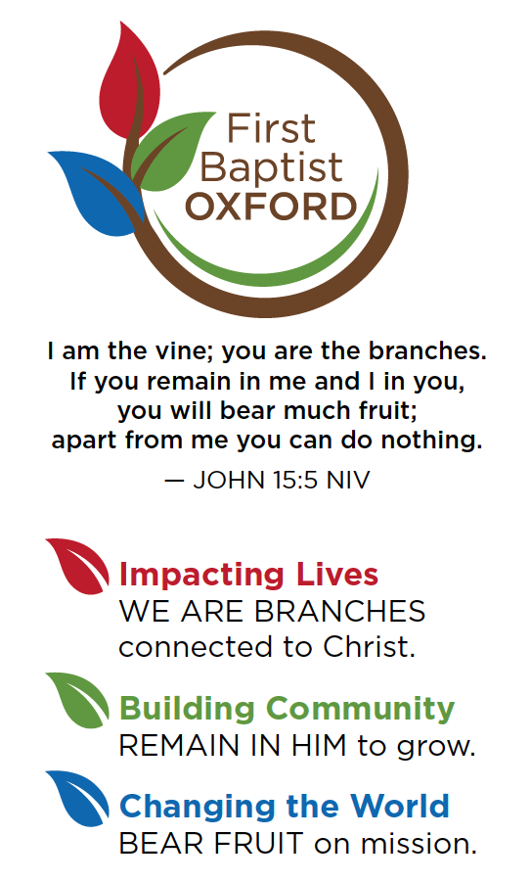
John 5:19 .. The Son can do nothing of Himself, unless it is something He sees the Father doing:
Why do we pray?
God commands us to pray.
Isaiah 55:6 .. Seek the Lord while he may be found; call upon him while he is near.
Prayer is a privilege.
Hebrews 4:16 .. Therefore, let us approach the throne of grace with boldness, so that we may receive mercy and find grace to help us in time of need.
A Great Tragedy of Life is Not Unanswered Prayer
But Unoffered Prayer.

Slide 10
WHEN YOU DEPEND ON GOD YOU PRAY. WHEN YOU DEPEND ON YOU YOU DON’T PRAY.
PRAYER BARRIERS
PRIDE .. OVERESTIMATING YOU.
UNBELIEF .. UNDERESTIMATING GOD.
IGNORANCE .. OVERESTIMATING THE DIFFICULTY OF TALKING WITH GOD.
TIME .. UNDERESTIMATING THE BENEFITS OF BEING WITH GOD.

